Slide 1
RELIGION & ETHICS

Slide 2
Foci in today’s lecture
Two versions of the idea about the religious source of morality
  Divine Command Theory
  Natural Law Theory
Two sociological perspectives on religion
  Positive – Religion has its social functions.
  Negative – Religion is the ‘opium of the people’
  (Karl Marx).
A political remark: Secularism in a democratic state

Slide 3
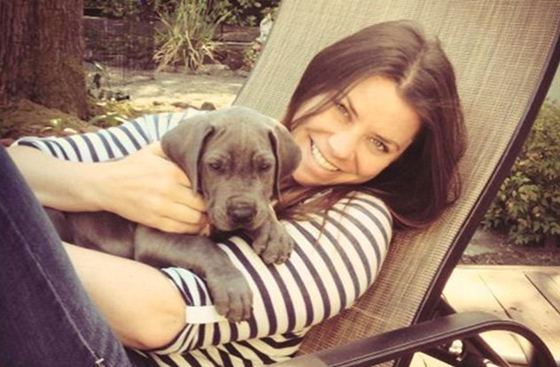

Slide 4
Brittany Maynard’s euthanasia
She was 29 (having just married for one year) when realizing that she had a malignant brain tumor. It is incurable. Normally a patient like this would die within 6 months. If she received an aggressive radiotherapy and chemotherapy for her cancer, she could have prolonged her life. Yet not wanting to have further pain and suffering, and to give burden to her family, she did not choose the radioactive or chemotherapy treatment. She decided to move from California to Oregon, where physician-assisted suicide is legal. She spent her final days to travel to Alaska, Yellowstone National Park, the Grand Canyons, and so on. Eventually she died at home, just after her husband’s birthday, surrounded by her loved ones.

Slide 5
Different responses
‘She is too hasty in making this decision.’ (Moral judgment)
  ‘Do not easily give up (your life).’ (Moral principle)
  ‘Life is sacred.’ (Moral principle)
‘She has responsibly thought about her situation thoroughly (including her medical condition, her family and her career, etc.) and made a wise (reasonable) choice of her own.’ (moral judgment)
  ‘You should exercise your moral autonomy.’ (Moral principle)
  ‘Live a good life.’ (Moral principle)

Slide 6
The religious source of morality (1)
Consider this moral principle in Response 1:
  ‘Life is sacred.’
    It means: Life is not merely a means for enjoyment, achievement and other values external to it. Life is intrinsically good; it is an end in itself (even though life includes pain and suffering).
On what grounds is life sacred or holy?
  ‘It is based on God’s will.’
  ‘That is the message from the Scriptures.’

Slide 7
The religious source of morality (2)
Consider this moral principle in Response 2:
  ‘You should exercise your moral autonomy.’
    You should determine your life (make your decisions) based on your reason.
    Reason enables us to be unbiased, impartial and objective.
However, the power of our reason is limited.
  There are conflicting reasons on many ethical matters, e.g., genetically modified (GM) food, test-tube babies, suicide, gay- (or lesbian-) marriage, and so on.
  It is God who finally determines what is right and what is wrong.
Dostoevsky’s famous words (via the claim of the character Ivan Karamazov in The Brothers Karamazov):
‘If God does not exist, then everything is permitted.’

Slide 8
What is a religion?
The 5 great religions on earth
  Christianity
  Hinduism
  Islam
  Buddhism
  Confucianism
It is difficult to define ‘religion’. For our purpose here, let’s consider some common characteristics that the 5 great religions share:
  Faith (deep commitment and devotion)
  Belief systems (what there is, our place in the universe, the meaning of life, etc.)
  Sacred texts
  Holy places
  Practices and rituals
  Ethics (including virtues/values, codes of conduct)
  The spiritual aspect of life

Slide 9
The idea about morality as ultimately determined by Deity (version 1)
DIVINE COMMAND THEORY
  Moral obligations are derived from moral principles, and moral principles should reflect God’s commands.
  Whether an action is morally right or wrong, and whether a person is good or bad, are ultimately determined by God’s will (and character).
    ‘Will’: Intention, preference, decision, command, want …
  God’s will, which is absolute, can override human reasons.
  Sin is disobedience to God’s moral order.

Slide 10
Moral norms
Moral values
God’s will

Slide 11
Are God’s purposes, preferences, judgments, etc. (i.e. His will) (1) intrinsically good or (2) constrained by independent, objective, standards?
If (1), then the problem is:
  whatever God thinks correct, then it is correct.
If (2), then the problem is:
  God, who is all powerful, must follow some moral norms He cannot determine.
How would Divine Command Theory answer?

Slide 12


The idea about morality as ultimately determined by Deity (version 2)
Natural law

Slide 13
NATURAL LAW THEORY
  There are objective, universal, laws (‘natural laws’) determining whether an action is right or wrong, and thus whether a person is good or bad.
  Humans can know and practise these ‘natural laws’ through their rational nature.
  The ‘natural laws’ and rational human nature are given by God.
  Note: what is emphasized here is not God’s will, but the inherent laws given by God.

Slide 14
‘Natural law’
This term is ambiguous. It can refer either to the objective and universal nature of either (a) moral laws or (b) legal laws.
Note: It does not mean any physical laws of nature.
Natural law | Positive law
Inherent rights (in nature and reason), not conferred by a social act of legislation, but by God. | Man-made; the law that applies at a certain time (present or past) at a certain place (i.e. society)

Slide 15
The natural laws are universal and unchangeable
Thanks to the natural laws, one can judge societies and their positive laws.
Positive (= actual ≠ good) laws of societies that are not in line with the natural law are not true laws but counterfeits.

Slide 16
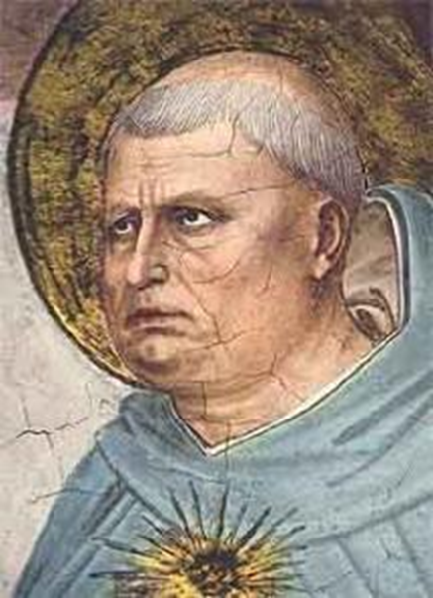
Thomas Aquinas, St. (1225-1274)
He is the founder and central figure of natural law ethics.
  A priest, theologian and allegedly one of the most important philosophers in the Middle Ages
Summa Theologica
‘The rule and measure of human acts is the reason, which is the first principle of human acts.’
  In his view, it is morally appropriate that human acts should conform to humans’ rational nature, which is given by God.

Slide 17
Natural law and divine providence
Why did God give us the natural law?
  It is an aspect of divine providence.
    ‘providence’ = care, guardianship, control and management (of the world)
  It is part of God’s rational plan by which all creation is ordered.
But it does not mean that, given the natural law, human beings have no moral autonomy.
  Due to reason, human beings are not merely compelled but can grasp and voluntarily follow the eternal law.

Slide 18
Thomistic ethics: what is the most fundamental grounds for our actions?
‘... this is the first precept [i.e., commandment or instruction, a general rule intended to regulate behaviour or thought] of the law, that good is to be done and promoted, and evil is to be avoided. All other precepts of the natural law are based on this …’ (Aquinas, Summa Theologica, question 94).
Note: e.g. the moral principle ‘Do no harm’ is derived from this first precept.

Slide 19
A question
  Is the natural law intrinsically authoritative? An obligation is essentially social; one is under an obligation only if one is subject to some sort of moral command in the context of a social relationship.
  An answer:
    It is true that moral laws should not be detached from social lives, in which we gain experiences in interacting with one another.
    But the final ground of moral norms should not be socially determined.
    Recall, in particular, the societies accepting master-slavery relationship, inequality between sexes, etc.

Slide 20
A grounding issue
Both Divine Command Theory and Natural Law Theory contend that ethics is ultimately grounded on some deity:
  Not social agreement
  Not human reason (but natural law, i.e. the reason given by God)
A dialogue:
  Can you justify this moral judgment?
  Yes, it is in accord with this moral principle.
  But is this moral principle all right?
  Yes, it is in accord with higher, more universal and fundamental, moral principles.
  But can you justify the higher-order moral principles?
  DCT: Yes, they are God’s command.
  NLT: Yes, they are natural laws given by God.
  But can you justify God’s commands? Can you justify the natural laws?
  No, they are final.

Slide 21
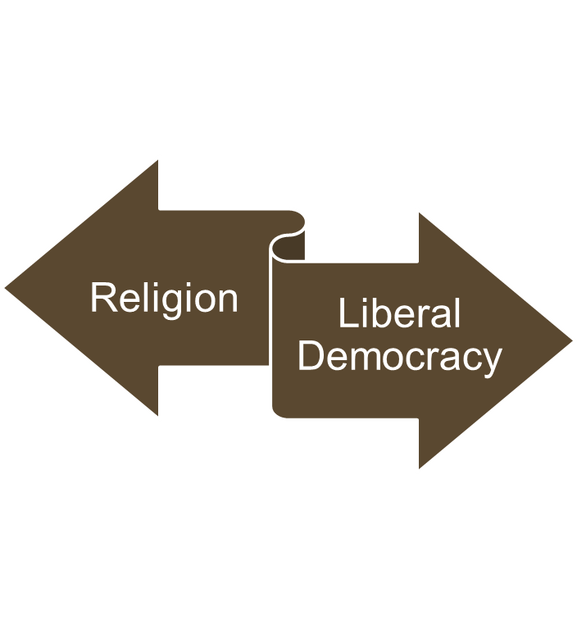
Religion as a problem for Liberal Democracy
Religion emphasizes tradition and absolute truth.
Liberal democracy emphasizes individuals’ independence, differences, and autonomy (reasonable choices and decisions).

Slide 22

Religion as a problem for multicultural societies
Religion emphasizes tradition and absolute truth.
‘Multicultural societies … find ways of reconciling unity and diversity, being inclusive without being assimilationist, cherishing plural cultural identities without weakening the precious identity of shared citizenship’
  (Bhikhu Parekh, Rethinking Multiculturalism, p. 343).

Slide 23
Religion: An absolutist (not relative) position
There is only one valid moral standard for all humans.
  What is a duty for me is also a duty for you, no matter whether you are a Fijian, British or savage in Africa.
  E.g., if human-sacrifice is an abomination (a thing that causes disgust or loathing) in Fiji and China, it should also be an abomination in Africa. If the people in Africa think otherwise, it is due to their ignorance.
That which is right (wrong) now should also be right (wrong) in ancient Greece, Rome, India, Persia, China, etc.
  E.g. sincerity -- right
  E.g. slavery system -- wrong
Problem: Religious truths are exclusive.

Slide 24
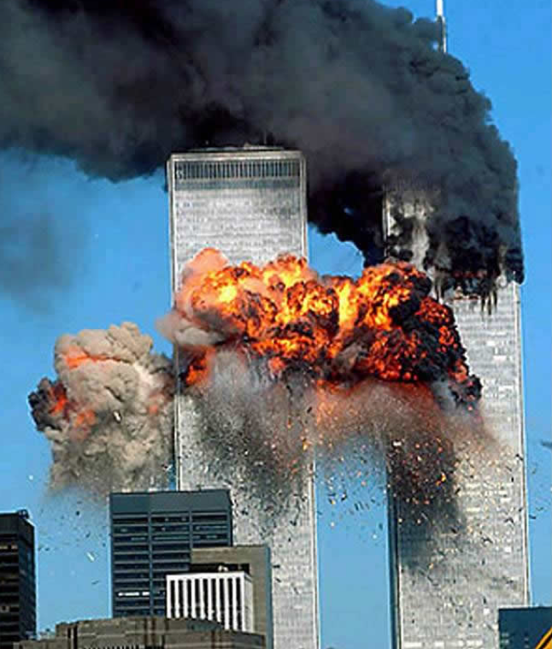
Religious violence – 9/11
2001, September 11th, Islamic Jihadists belonging to a militant Islamic fundamentalist group called Al Qaeda flew two commercial airplanes into the World Trade Centre Twin Towers in New York.
2606 people lost their lives, however arguably the later fallout has been more traumatic and devastating.
The US declared a “War on Terror”, invading Afghanistan and Iraq resulting in the deaths of 100,000 people.
Al Qaeda remains and continues with violent attacks across the world.

Slide 25
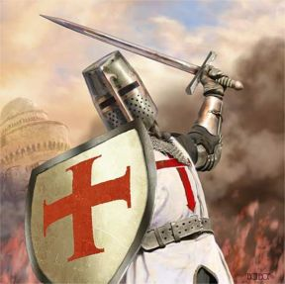
But it is not just ISLAMic jihadists!
European Christians led three wars against the Muslims and Jews of the Holy Lands (Modern day Israel) in the 11th, 12th, and 13th Centuries.
It is estimated that around
900,000 died in the lead up to
the capture of Jerusalem.
The Muslims soon took it back,
under Saladin in 1187 AD.
Moreover, in the 16th and 17th centuries, in Europe there were series of religious wars between the Catholics and Protestants.

Slide 26
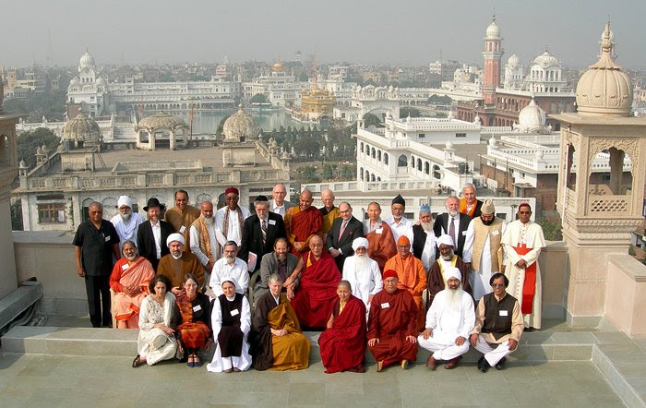

Slide 27
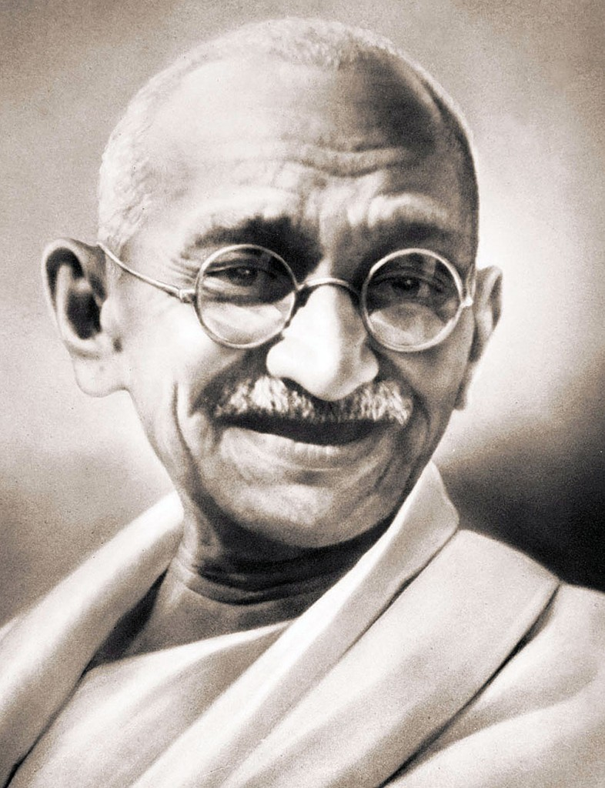
Mahatma Gandhi
Gandhi:
  “Eye for an eye will make the whole world blind”,
  “One should avoid harming any living thing, and also avoid the desire to harm any living thing”
Ahimsa (the principle of nonviolence toward all living things)

Slide 28

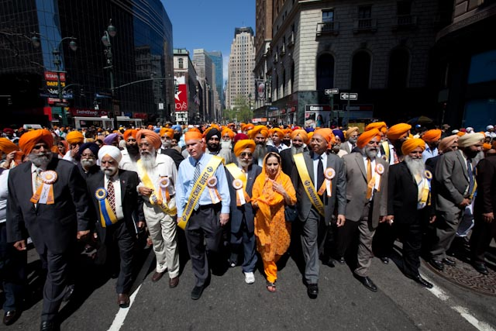
Religions’ functions:
1. Social solidarity and identity
Religion enables us to share values and beliefs. It helps bind us into a community. In addition, it provides identity, and instills a sense of fellowship.

Slide 29
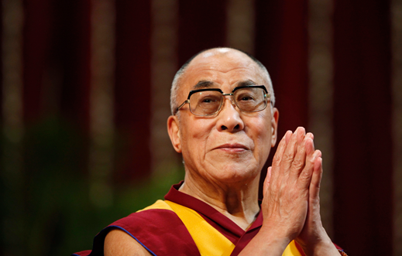
2. Religions cultivate important virtues.
Religions reinforce respect, love, tolerance, patience and understanding, which are essential for any society.
  “Whatever makes you
  more compassionate,
  more sensible,
  more detached,
  more loving,
  more humanitarian,
  more responsible,
  more ethical [can make you better].”
  “The religion that will do that for you is the best religion.”
  The Dalai Lama

Slide 30
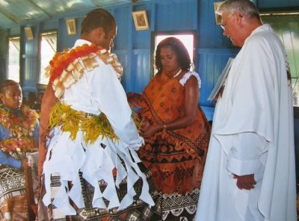
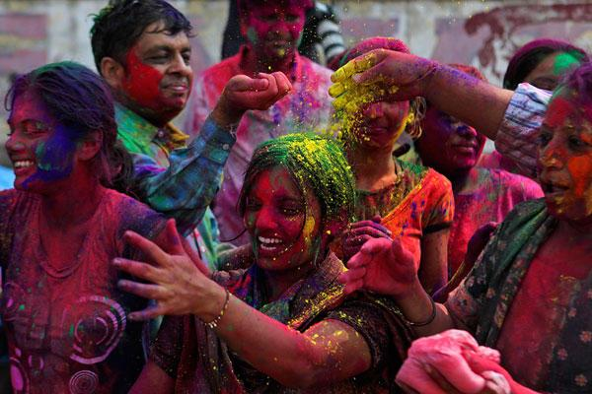
3. Celebrate life and intensify meaning
Rituals at key events, birth, puberty, marriage and death are there to make sacred the most significant changes we undergo in our lives.
Often before the ritual, we have one social position or status, and after the ritual we have been transformed into a new member of the community.
Religions often tie in with the seasons, celebrating the wonder of the world, as a great gift that has been received.
We are reminded of the wonder of life and our good fortune to have a place in this world.

Slide 31
Religions in a secular world
FNU is a secular university.
The Republic of Fiji Islands is a secular state.
But note:
Secularism is not the same as:
    Atheism – the belief that there is no God.
    Agnosticism – the belief we cannot know whether God exists or not.

Slide 32
The term ‘secularism’
Ambiguous (= with more than one meaning)
Sense 1
  ‘indifference to or rejection or exclusion of religion and religious considerations’ (Merriam Webster)
Sense 2
  the principle of separation of the state from religious institutions
  no discrimination against anybody in the name of religion
  religion should not be involved with the ordinary social and political activities of a country

Slide 33
Religions in a secular world
Secularism is the principle or view that religion and the state, or any institution in the public sphere (including education) needs to be free of religious control:
  Laws are not to be made on religious grounds.
  No religious discrimination.
  Everyone has the freedom of religion.
= ‘Overlapping consensus’, pluralism, multiculturalism
In liberal democracy, the state is neutral.
Why is secularism so important?

Slide 34

Religion in a secular world
Fiji is a multicultural society with a rich diversity of cultural traditions. If the country prioritized one religion it would fail as a democracy.
Restricting freedom of religion would also lead to public disorder as religion is something for which people are prepared to fight!
Ultimately, it is an issue of mutual respect and mutual interest.

Slide 35
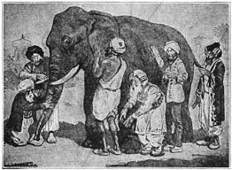
https://www.peacecorps.gov/educators/resources/story-blind-men-and-elephant/

Slide 36
Religions in a secular world
We need to be humble about what we know. All religions contain various wisdoms that other religions can learn.
It is to our mutual interests to listen to one another; especially on such matters (ethics included) where there is so much doubt and confusion.

